Slide 1
BTS & STORE

Slide 2

Contents
1
2
시장조사
페르소나
5
3
평가
4
기획
구현

Slide 3
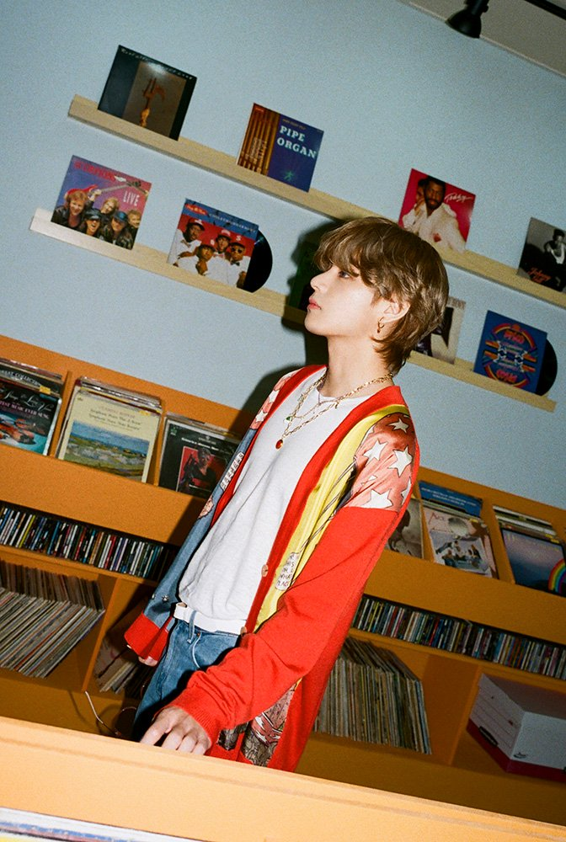
1
Main title
SLIDE SUBTITLE SLIDE SUBTITLE SLIDE SUBTITLE SLIDE SUBTITLE

Slide 4
1
Main title
SLIDE SUBTITLE
Please fill out the contents. Please fill out the contents.
Please fill out the contents. Please fill out the contents.
Please fill out the contents. Please fill out the contents.
Please fill out the contents. Please fill out the contents.

Slide 5
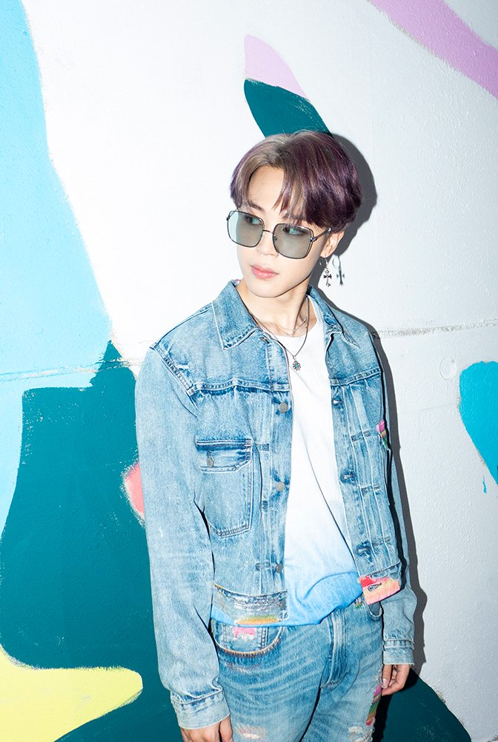
Q&A
SLIDE SUBTITLE SLIDE SUBTITLE SLIDE SUBTITLE SLIDE SUBTITLE

Slide 6
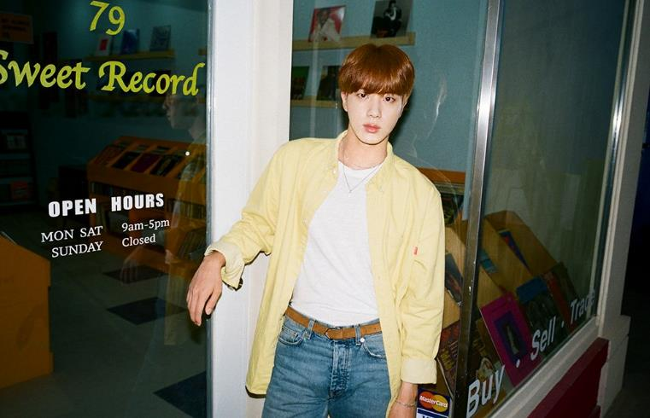
Thank you
Dynamite power point template
Copyright ⓒ 2020. eundingding All rights Reserved

